Slide 1
Les métaphores
Poetry Workshop

Slide 2
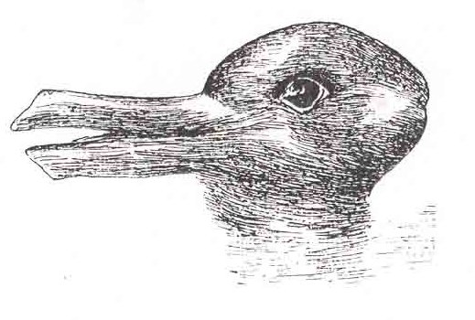
Les perceptions I: Qu’est-ce que vous voyez?
C’est un canard…
…ou un lapin?
Notes:
Slides 2 – 4
This is a fun activity about changing perceptions.
Learners may be familiar with these images as they feature in a prominent psychological study.
They can use any previous knowledge to scaffold this task which will make it more light-hearted and fun.

Slide 3
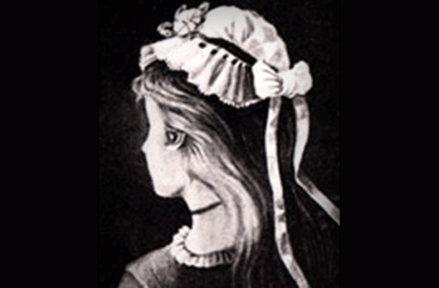
Les perceptions I: Qu’est-ce que vous voyez?
C’est une jeune fille…
…ou une vielle dame?

Slide 4
Les perceptions I: Qu’est-ce que vous voyez?
C’est un âne…
…ou un phoque?

Slide 5
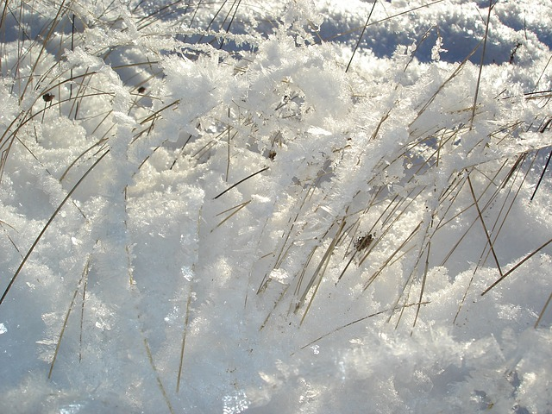
Les perceptions II: Qu’est-ce que c’est?
Le coucher de soleil
Un lit de clous
La neige à l’herbe
La danse de bonhommes batons
L’arc-en-ciel
Notes:
Slides 5- 7
This activity first asks learners to choose a plain speech description from the left hand side of the image. Learners may work together using any support deemed necessary.
The second part asks them to consider poetic language, i.e. the metaphor. Learners decode and choose the metaphor from the right hand side of the image they think is most effective and say why. Discuss this with the class.

Slide 6
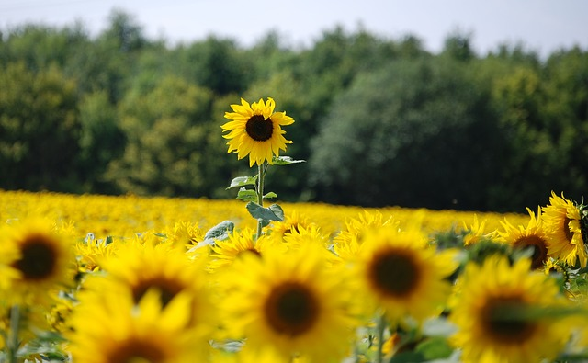
Les perceptions II: Qu’est-ce que c’est?
Un champs de tournesol
Un grand monsieur sous le soleil
Une corbeille de roses
Un soleil enchainé à la terre
Un terrain vague

Slide 7
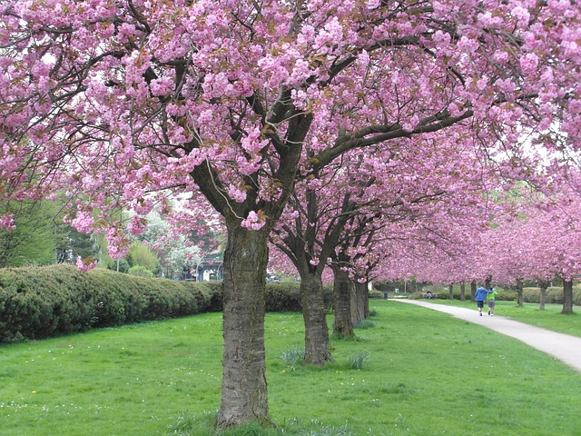
Les perceptions II: Qu’est-ce que c’est?
Un espace vert
La vie en rose
Une rue piétonne
Un ciel barbe à papa
Des cerisiers en fleurs

Slide 8
Mes sens…
Je vois…
J’entends…
Je sens…
Je goûte…
Je touche…
Notes:
Slides 9 – 12
Before learners compose their own “I am” poems, these slides ask them to work in groups completing the sentences from the perspective of the sunflower. (You may use any other image or object)
Learners may do this activity like a game of “Consequences” where one person writes a line then passes it on to the next person to complete the next line.
After each slide bring the class together and discuss what they have written. What interesting language has been used? What interesting perspectives did they think of?

Slide 9
Mes sentiments et mes pensées
Je pense à…
Je me sens…
Je connais…
J’imagine…

Slide 10
Mes espoirs et mes craintes
Je rêve de…
J’ai peur de…
J’espère…

Slide 11
Mes désirs
Je veux…
J’adore…
J’ai besoin de…

Slide 12
Qui suis-je?
Je suis _______________
Je vois _______________
J’entends _________________
Je sens __________________
Je goûte ________________
Je touche _______________
Je suis _______________
Notes:
Slides 13 – 15
Now bring the class together. Using a selection of sentences from each group compose a whole class “I am” poem based on the perspective of the sunflower (or other object).
You may decide which sentences to use by asking each group to write their responses on flipchart paper, sticking these to the board/wall and asking the class to put a tick next to their favourite sentences.

Slide 13
J’imagine _______________
Je connais _______________
Je me sens _________________
J’ai peur de__________________
J’ai besoin de _______________
Je suis _______________

Slide 14
Who am I?
Je veux _______________
Je pense à _______________
Je rêve de_________________
J’adore __________________
J’espère _______________
Je suis _______________

Slide 15
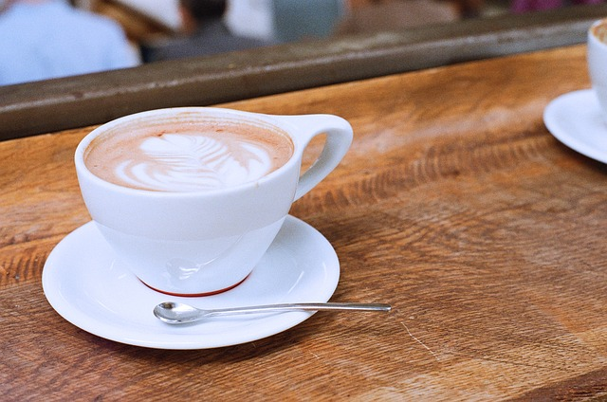
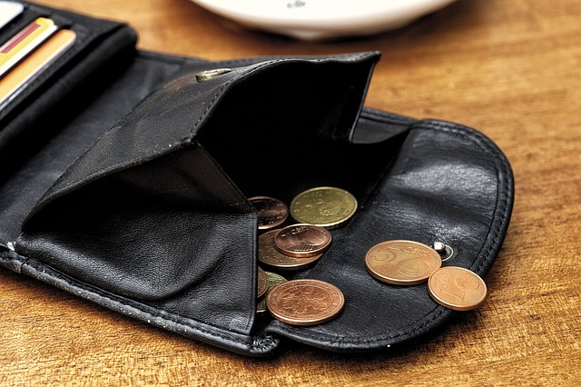
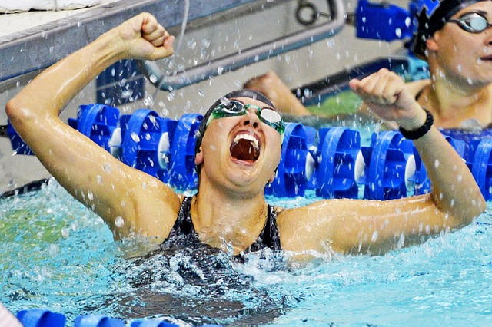
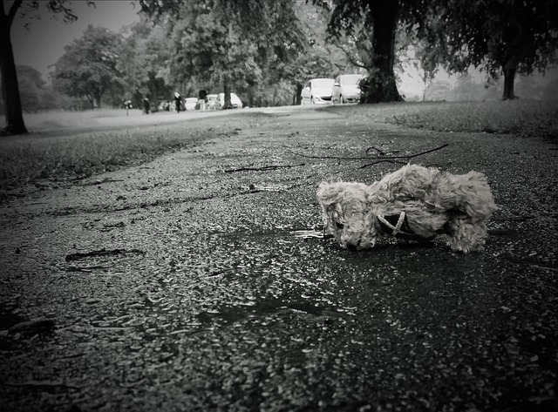
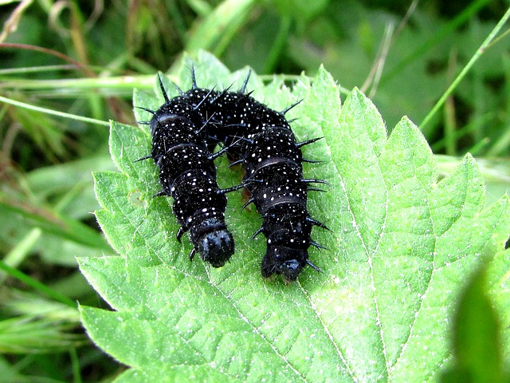
Notes:
Slides 16-17
Using the structure of the “I am” poem in the last slides 13 - 15, learners write their own “I am” poem in the target language.
You may provide images, like these, or a mystery box of objects as inspiration. If studying a text in the target language, learners may write their poems from the perspective of one of the characters. Learners may write their poem from the perspective of a more personal object or person they know.

Slide 16
